Slide 1
요구사항 확인
작성일 : 2024 - 03 - 14
개발팀원 : 강지영, 윤지원, 이재형, 조은지

Slide 2
Part 1
Part 1
1
소프트웨어 환경
2
하드웨어 환경
3
OS 종류
4
Database 종류
5
WAS 종류

Slide 3
%3CmxGraphModel%3E%3Croot%3E%3CmxCell%20id%3D%220%22%2F%3E%3CmxCell%20id%3D%221%22%20parent%3D%220%22%2F%3E%3CmxCell%20id%3D%222%22%20value%3D%22%22%20style%3D%22shape%3Dtable%3BstartSize%3D0%3Bcontainer%3D1%3Bcollapsible%3D0%3BchildLayout%3DtableLayout%3B%22%20vertex%3D%221%22%20parent%3D%221%22%3E%3CmxGeometry%20x%3D%2270%22%20y%3D%22110%22%20width%3D%22554%22%20height%3D%22195%22%20as%3D%22geometry%22%2F%3E%3C%2FmxCell%3E%3CmxCell%20id%3D%223%22%20value%3D%22%22%20style%3D%22shape%3DtableRow%3Bhorizontal%3D0%3BstartSize%3D0%3BswimlaneHead%3D0%3BswimlaneBody%3D0%3BstrokeColor%3Dinherit%3Btop%3D0%3Bleft%3D0%3Bbottom%3D0%3Bright%3D0%3Bcollapsible%3D0%3BdropTarget%3D0%3BfillColor%3Dnone%3Bpoints%3D%5B%5B0%2C0.5%5D%2C%5B1%2C0.5%5D%5D%3BportConstraint%3Deastwest%3B%22%20vertex%3D%221%22%20parent%3D%222%22%3E%3CmxGeometry%20width%3D%22554%22%20height%3D%2247%22%20as%3D%22geometry%22%2F%3E%3C%2FmxCell%3E%3CmxCell%20id%3D%224%22%20value%3D%22%EA%B5%AC%EB%B6%84%22%20style%3D%22shape%3DpartialRectangle%3Bhtml%3D1%3BwhiteSpace%3Dwrap%3Bconnectable%3D0%3BstrokeColor%3Dinherit%3Boverflow%3Dhidden%3BfillColor%3Dnone%3Btop%3D0%3Bleft%3D0%3Bbottom%3D0%3Bright%3D0%3BpointerEvents%3D1%3B%22%20vertex%3D%221%22%20parent%3D%223%22%3E%3CmxGeometry%20width%3D%2255%22%20height%3D%2247%22%20as%3D%22geometry%22%3E%3CmxRectangle%20width%3D%2255%22%20height%3D%2247%22%20as%3D%22alternateBounds%22%2F%3E%3C%2FmxGeometry%3E%3C%2FmxCell%3E%3CmxCell%20id%3D%225%22%20value%3D%22%EC%8B%9C%EC%8A%A4%ED%85%9C%EB%AA%85%22%20style%3D%22shape%3DpartialRectangle%3Bhtml%3D1%3BwhiteSpace%3Dwrap%3Bconnectable%3D0%3BstrokeColor%3Dinherit%3Boverflow%3Dhidden%3BfillColor%3Dnone%3Btop%3D0%3Bleft%3D0%3Bbottom%3D0%3Bright%3D0%3BpointerEvents%3D1%3B%22%20vertex%3D%221%22%20parent%3D%223%22%3E%3CmxGeometry%20x%3D%2255%22%20width%3D%2261%22%20height%3D%2247%22%20as%3D%22geometry%22%3E%3CmxRectangle%20width%3D%2261%22%20height%3D%2247%22%20as%3D%22alternateBounds%22%2F%3E%3C%2FmxGeometry%3E%3C%2FmxCell%3E%3CmxCell%20id%3D%226%22%20value%3D%22SW%EC%A0%9C%ED%92%88%EB%AA%85%22%20style%3D%22shape%3DpartialRectangle%3Bhtml%3D1%3BwhiteSpace%3Dwrap%3Bconnectable%3D0%3BstrokeColor%3Dinherit%3Boverflow%3Dhidden%3BfillColor%3Dnone%3Btop%3D0%3Bleft%3D0%3Bbottom%3D0%3Bright%3D0%3BpointerEvents%3D1%3B%22%20vertex%3D%221%22%20parent%3D%223%22%3E%3CmxGeometry%20x%3D%22116%22%20width%3D%22131%22%20height%3D%2247%22%20as%3D%22geometry%22%3E%3CmxRectangle%20width%3D%22131%22%20height%3D%2247%22%20as%3D%22alternateBounds%22%2F%3E%3C%2FmxGeometry%3E%3C%2FmxCell%3E%3CmxCell%20id%3D%227%22%20value%3D%22%EC%9A%A9%EB%8F%84%22%20style%3D%22shape%3DpartialRectangle%3Bhtml%3D1%3BwhiteSpace%3Dwrap%3Bconnectable%3D0%3BstrokeColor%3Dinherit%3Boverflow%3Dhidden%3BfillColor%3Dnone%3Btop%3D0%3Bleft%3D0%3Bbottom%3D0%3Bright%3D0%3BpointerEvents%3D1%3B%22%20vertex%3D%221%22%20parent%3D%223%22%3E%3CmxGeometry%20x%3D%22247%22%20width%3D%2291%22%20height%3D%2247%22%20as%3D%22geometry%22%3E%3CmxRectangle%20width%3D%2291%22%20height%3D%2247%22%20as%3D%22alternateBounds%22%2F%3E%3C%2FmxGeometry%3E%3C%2FmxCell%3E%3CmxCell%20id%3D%228%22%20value%3D%22%EB%9D%BC%EC%9D%B4%EC%84%A0%EC%8A%A4%20%EC%A0%81%EC%9A%A9%EB%B0%A9%22%20style%3D%22shape%3DpartialRectangle%3Bhtml%3D1%3BwhiteSpace%3Dwrap%3Bconnectable%3D0%3BstrokeColor%3Dinherit%3Boverflow%3Dhidden%3BfillColor%3Dnone%3Btop%3D0%3Bleft%3D0%3Bbottom%3D0%3Bright%3D0%3BpointerEvents%3D1%3B%22%20vertex%3D%221%22%20parent%3D%223%22%3E%3CmxGeometry%20x%3D%22338%22%20width%3D%22107%22%20height%3D%2247%22%20as%3D%22geometry%22%3E%3CmxRectangle%20width%3D%22107%22%20height%3D%2247%22%20as%3D%22alternateBounds%22%2F%3E%3C%2FmxGeometry%3E%3C%2FmxCell%3E%3CmxCell%20id%3D%229%22%20value%3D%22%EB%9D%BC%EC%9D%B4%EC%84%A0%EC%8A%A4%20%EC%88%98%22%20style%3D%22shape%3DpartialRectangle%3Bhtml%3D1%3BwhiteSpace%3Dwrap%3Bconnectable%3D0%3BstrokeColor%3Dinherit%3Boverflow%3Dhidden%3BfillColor%3Dnone%3Btop%3D0%3Bleft%3D0%3Bbottom%3D0%3Bright%3D0%3BpointerEvents%3D1%3B%22%20vertex%3D%221%22%20parent%3D%223%22%3E%3CmxGeometry%20x%3D%22445%22%20width%3D%22109%22%20height%3D%2247%22%20as%3D%22geometry%22%3E%3CmxRectangle%20width%3D%22109%22%20height%3D%2247%22%20as%3D%22alternateBounds%22%2F%3E%3C%2FmxGeometry%3E%3C%2FmxCell%3E%3CmxCell%20id%3D%2210%22%20value%3D%22%22%20style%3D%22shape%3DtableRow%3Bhorizontal%3D0%3BstartSize%3D0%3BswimlaneHead%3D0%3BswimlaneBody%3D0%3BstrokeColor%3Dinherit%3Btop%3D0%3Bleft%3D0%3Bbottom%3D0%3Bright%3D0%3Bcollapsible%3D0%3BdropTarget%3D0%3BfillColor%3Dnone%3Bpoints%3D%5B%5B0%2C0.5%5D%2C%5B1%2C0.5%5D%5D%3BportConstraint%3Deastwest%3B%22%20vertex%3D%221%22%20parent%3D%222%22%3E%3CmxGeometry%20y%3D%2247%22%20width%3D%22554%22%20height%3D%2287%22%20as%3D%22geometry%22%2F%3E%3C%2FmxCell%3E%3CmxCell%20id%3D%2211%22%20value%3D%22%EA%B8%B0%EA%B0%84%26lt%3Bbr%26gt%3B%EC%97%85%EB%AC%B4%22%20style%3D%22shape%3DpartialRectangle%3Bhtml%3D1%3BwhiteSpace%3Dwrap%3Bconnectable%3D0%3BstrokeColor%3Dinherit%3Boverflow%3Dhidden%3BfillColor%3Dnone%3Btop%3D0%3Bleft%3D0%3Bbottom%3D0%3Bright%3D0%3BpointerEvents%3D1%3Browspan%3D2%3Bcolspan%3D1%3B%22%20vertex%3D%221%22%20parent%3D%2210%22%3E%3CmxGeometry%20width%3D%2255%22%20height%3D%22148%22%20as%3D%22geometry%22%3E%3CmxRectangle%20width%3D%2255%22%20height%3D%2287%22%20as%3D%22alternateBounds%22%2F%3E%3C%2FmxGeometry%3E%3C%2FmxCell%3E%3CmxCell%20id%3D%2212%22%20value%3D%22%EC%8B%9C%EC%8A%A4%ED%85%9CA%22%20style%3D%22shape%3DpartialRectangle%3Bhtml%3D1%3BwhiteSpace%3Dwrap%3Bconnectable%3D0%3BstrokeColor%3Dinherit%3Boverflow%3Dhidden%3BfillColor%3Dnone%3Btop%3D0%3Bleft%3D0%3Bbottom%3D0%3Bright%3D0%3BpointerEvents%3D1%3Browspan%3D2%3Bcolspan%3D1%3B%22%20vertex%3D%221%22%20parent%3D%2210%22%3E%3CmxGeometry%20x%3D%2255%22%20width%3D%2261%22%20height%3D%22148%22%20as%3D%22geometry%22%3E%3CmxRectangle%20width%3D%2261%22%20height%3D%2287%22%20as%3D%22alternateBounds%22%2F%3E%3C%2FmxGeometry%3E%3C%2FmxCell%3E%3CmxCell%20id%3D%2213%22%20value%3D%22Apche%20Tomcat%209.0.64%22%20style%3D%22shape%3DpartialRectangle%3Bhtml%3D1%3BwhiteSpace%3Dwrap%3Bconnectable%3D0%3BstrokeColor%3Dinherit%3Boverflow%3Dhidden%3BfillColor%3Dnone%3Btop%3D0%3Bleft%3D0%3Bbottom%3D0%3Bright%3D0%3BpointerEvents%3D1%3B%22%20vertex%3D%221%22%20parent%3D%2210%22%3E%3CmxGeometry%20x%3D%22116%22%20width%3D%22131%22%20height%3D%2287%22%20as%3D%22geometry%22%3E%3CmxRectangle%20width%3D%22131%22%20height%3D%2287%22%20as%3D%22alternateBounds%22%2F%3E%3C%2FmxGeometry%3E%3C%2FmxCell%3E%3CmxCell%20id%3D%2214%22%20value%3D%22%EC%84%9C%EB%B2%84%22%20style%3D%22shape%3DpartialRectangle%3Bhtml%3D1%3BwhiteSpace%3Dwrap%3Bconnectable%3D0%3BstrokeColor%3Dinherit%3Boverflow%3Dhidden%3BfillColor%3Dnone%3Btop%3D0%3Bleft%3D0%3Bbottom%3D0%3Bright%3D0%3BpointerEvents%3D1%3B%22%20vertex%3D%221%22%20parent%3D%2210%22%3E%3CmxGeometry%20x%3D%22247%22%20width%3D%2291%22%20height%3D%2287%22%20as%3D%22geometry%22%3E%3CmxRectangle%20width%3D%2291%22%20height%3D%2287%22%20as%3D%22alternateBounds%22%2F%3E%3C%2FmxGeometry%3E%3C%2FmxCell%3E%3CmxCell%20id%3D%2215%22%20value%3D%22%EB%AA%A8%EB%93%A0%EC%98%A4%ED%94%88%EC%86%8C%EC%8A%A4%26lt%3Bbr%26gt%3BApache%26lt%3Bbr%26gt%3Blicense%22%20style%3D%22shape%3DpartialRectangle%3Bhtml%3D1%3BwhiteSpace%3Dwrap%3Bconnectable%3D0%3BstrokeColor%3Dinherit%3Boverflow%3Dhidden%3BfillColor%3Dnone%3Btop%3D0%3Bleft%3D0%3Bbottom%3D0%3Bright%3D0%3BpointerEvents%3D1%3B%22%20vertex%3D%221%22%20parent%3D%2210%22%3E%3CmxGeometry%20x%3D%22338%22%20width%3D%22107%22%20height%3D%2287%22%20as%3D%22geometry%22%3E%3CmxRectangle%20width%3D%22107%22%20height%3D%2287%22%20as%3D%22alternateBounds%22%2F%3E%3C%2FmxGeometry%3E%3C%2FmxCell%3E%3CmxCell%20id%3D%2216%22%20value%3D%221%22%20style%3D%22shape%3DpartialRectangle%3Bhtml%3D1%3BwhiteSpace%3Dwrap%3Bconnectable%3D0%3BstrokeColor%3Dinherit%3Boverflow%3Dhidden%3BfillColor%3Dnone%3Btop%3D0%3Bleft%3D0%3Bbottom%3D0%3Bright%3D0%3BpointerEvents%3D1%3B%22%20vertex%3D%221%22%20parent%3D%2210%22%3E%3CmxGeometry%20x%3D%22445%22%20width%3D%22109%22%20height%3D%2287%22%20as%3D%22geometry%22%3E%3CmxRectangle%20width%3D%22109%22%20height%3D%2287%22%20as%3D%22alternateBounds%22%2F%3E%3C%2FmxGeometry%3E%3C%2FmxCell%3E%3CmxCell%20id%3D%2217%22%20value%3D%22%22%20style%3D%22shape%3DtableRow%3Bhorizontal%3D0%3BstartSize%3D0%3BswimlaneHead%3D0%3BswimlaneBody%3D0%3BstrokeColor%3Dinherit%3Btop%3D0%3Bleft%3D0%3Bbottom%3D0%3Bright%3D0%3Bcollapsible%3D0%3BdropTarget%3D0%3BfillColor%3Dnone%3Bpoints%3D%5B%5B0%2C0.5%5D%2C%5B1%2C0.5%5D%5D%3BportConstraint%3Deastwest%3B%22%20vertex%3D%221%22%20parent%3D%222%22%3E%3CmxGeometry%20y%3D%22134%22%20width%3D%22554%22%20height%3D%2261%22%20as%3D%22geometry%22%2F%3E%3C%2FmxCell%3E%3CmxCell%20id%3D%2218%22%20value%3D%22%22%20style%3D%22shape%3DpartialRectangle%3Bhtml%3D1%3BwhiteSpace%3Dwrap%3Bconnectable%3D0%3BstrokeColor%3Dinherit%3Boverflow%3Dhidden%3BfillColor%3Dnone%3Btop%3D0%3Bleft%3D0%3Bbottom%3D0%3Bright%3D0%3BpointerEvents%3D1%3B%22%20vertex%3D%221%22%20visible%3D%220%22%20parent%3D%2217%22%3E%3CmxGeometry%20width%3D%2255%22%20height%3D%2261%22%20as%3D%22geometry%22%3E%3CmxRectangle%20width%3D%2255%22%20height%3D%2261%22%20as%3D%22alternateBounds%22%2F%3E%3C%2FmxGeometry%3E%3C%2FmxCell%3E%3CmxCell%20id%3D%2219%22%20value%3D%22%22%20style%3D%22shape%3DpartialRectangle%3Bhtml%3D1%3BwhiteSpace%3Dwrap%3Bconnectable%3D0%3BstrokeColor%3Dinherit%3Boverflow%3Dhidden%3BfillColor%3Dnone%3Btop%3D0%3Bleft%3D0%3Bbottom%3D0%3Bright%3D0%3BpointerEvents%3D1%3B%22%20vertex%3D%221%22%20visible%3D%220%22%20parent%3D%2217%22%3E%3CmxGeometry%20x%3D%2255%22%20width%3D%2261%22%20height%3D%2261%22%20as%3D%22geometry%22%3E%3CmxRectangle%20width%3D%2261%22%20height%3D%2261%22%20as%3D%22alternateBounds%22%2F%3E%3C%2FmxGeometry%3E%3C%2FmxCell%3E%3CmxCell%20id%3D%2220%22%20value%3D%22MySQL%22%20style%3D%22shape%3DpartialRectangle%3Bhtml%3D1%3BwhiteSpace%3Dwrap%3Bconnectable%3D0%3BstrokeColor%3Dinherit%3Boverflow%3Dhidden%3BfillColor%3Dnone%3Btop%3D0%3Bleft%3D0%3Bbottom%3D0%3Bright%3D0%3BpointerEvents%3D1%3B%22%20vertex%3D%221%22%20parent%3D%2217%22%3E%3CmxGeometry%20x%3D%22116%22%20width%3D%22131%22%20height%3D%2261%22%20as%3D%22geometry%22%3E%3CmxRectangle%20width%3D%22131%22%20height%3D%2261%22%20as%3D%22alternateBounds%22%2F%3E%3C%2FmxGeometry%3E%3C%2FmxCell%3E%3CmxCell%20id%3D%2221%22%20value%3D%22%EB%8D%B0%EC%9D%B4%ED%84%B0%20%EB%B2%A0%EC%9D%B4%EC%8A%A4%22%20style%3D%22shape%3DpartialRectangle%3Bhtml%3D1%3BwhiteSpace%3Dwrap%3Bconnectable%3D0%3BstrokeColor%3Dinherit%3Boverflow%3Dhidden%3BfillColor%3Dnone%3Btop%3D0%3Bleft%3D0%3Bbottom%3D0%3Bright%3D0%3BpointerEvents%3D1%3B%22%20vertex%3D%221%22%20parent%3D%2217%22%3E%3CmxGeometry%20x%3D%22247%22%20width%3D%2291%22%20height%3D%2261%22%20as%3D%22geometry%22%3E%3CmxRectangle%20width%3D%2291%22%20height%3D%2261%22%20as%3D%22alternateBounds%22%2F%3E%3C%2FmxGeometry%3E%3C%2FmxCell%3E%3CmxCell%20id%3D%2222%22%20value%3D%22GPL%EB%98%90%EB%8A%94%20%EC%83%81%EC%9A%A9%22%20style%3D%22shape%3DpartialRectangle%3Bhtml%3D1%3BwhiteSpace%3Dwrap%3Bconnectable%3D0%3BstrokeColor%3Dinherit%3Boverflow%3Dhidden%3BfillColor%3Dnone%3Btop%3D0%3Bleft%3D0%3Bbottom%3D0%3Bright%3D0%3BpointerEvents%3D1%3B%22%20vertex%3D%221%22%20parent%3D%2217%22%3E%3CmxGeometry%20x%3D%22338%22%20width%3D%22107%22%20height%3D%2261%22%20as%3D%22geometry%22%3E%3CmxRectangle%20width%3D%22107%22%20height%3D%2261%22%20as%3D%22alternateBounds%22%2F%3E%3C%2FmxGeometry%3E%3C%2FmxCell%3E%3CmxCell%20id%3D%2223%22%20value%3D%221%22%20style%3D%22shape%3DpartialRectangle%3Bhtml%3D1%3BwhiteSpace%3Dwrap%3Bconnectable%3D0%3BstrokeColor%3Dinherit%3Boverflow%3Dhidden%3BfillColor%3Dnone%3Btop%3D0%3Bleft%3D0%3Bbottom%3D0%3Bright%3D0%3BpointerEvents%3D1%3B%22%20vertex%3D%221%22%20parent%3D%2217%22%3E%3CmxGeometry%20x%3D%22445%22%20width%3D%22109%22%20height%3D%2261%22%20as%3D%22geometry%22%3E%3CmxRectangle%20width%3D%22109%22%20height%3D%2261%22%20as%3D%22alternateBounds%22%2F%3E%3C%2FmxGeometry%3E%3C%2FmxCell%3E%3C%2Froot%3E%3C%2FmxGraphModel%3E
소프트웨어 환경
소프트웨어 환경
구분 | 시스템명 | SW제품명수 | 용도 | 라이선스 적용방 | 라이선스 수
기간 업무 | 시스템 A | Apche Tomcat 9.0.64 | 서버 | 오픈소스 Apache licnese | 1
 |  | MySQL | 데이터 베이스 | GPL또는 상용 | 1

Slide 4
하드웨어 환경
구분 | 시스템명 | 서버용도 | 제품명 | 주요 사양 | 수량 | 이중화
기간 업무 | 시스템A | AP 서버 |  |  | 1 | N
 |  | DB 서버 |  |  | 1 | N
하드웨어 환경

Slide 5
OS 종류
종류 | 저작자 | predecessor | 비용 및 라이선스 | 주요 용도
WIndows | Microsoft | OS / 2,MS-DOS | 유상, 다양한 라이선스 정책 | 중소 규모 서버, 개인용 PC, Tablet PC, Embedded System
Linux | Linus Tovalds | Linux kernel | 무료, GNU GPLv2 | 중대 규모 서버
Android | Google | Linux | 무료, Apache 2.0, GNU GPLv2 | 스마트폰, 태블릿 PC
OS 종류

Slide 6
Database 종류
- 이번 프로젝트에서 사용하는 DB
종류 | 저작자 | 비용 및 라이선스 | 주요 용도
MySQL | Microsoft | 상용 | 중소 규모 데이터의 안정적인 처리
이미지
이미지
이미지
Database 종류

Slide 7
WAS 종류
쓰여진 WAS | 저작자 | 비용 및 라이선스 | 주요 용도 | 쓰여진 WAS | 벤더
Apache Tomcat 10.0 | Apache | 오픈소스 | 서버 연결 | Apache Tomcat 10.0 | Apache
이미지
이미지
이미지
WAS 종류

Slide 8
Part 2
Part 2
1
요구사항 정리
2
USECASE
3
ERD
4
클래스 다이어그램
5
API 문서화

Slide 9
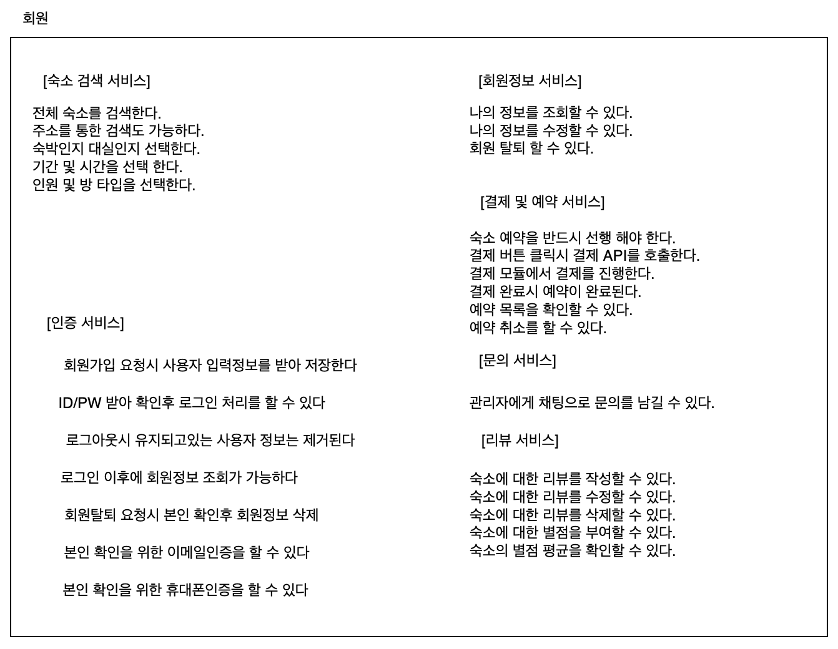
요구사항 정리 - 회원
요구사항 정리

Slide 10
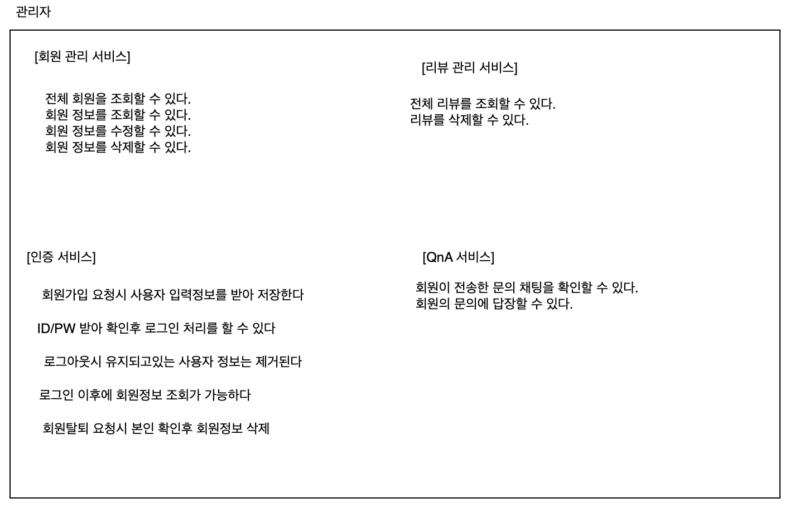
요구사항 정리 - 관리자
요구사항 정리

Slide 11
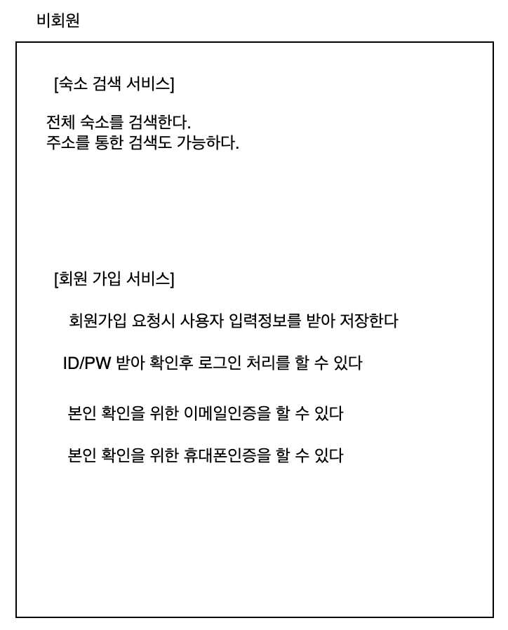
요구사항 정리 - 비회원
요구사항 정리

Slide 12
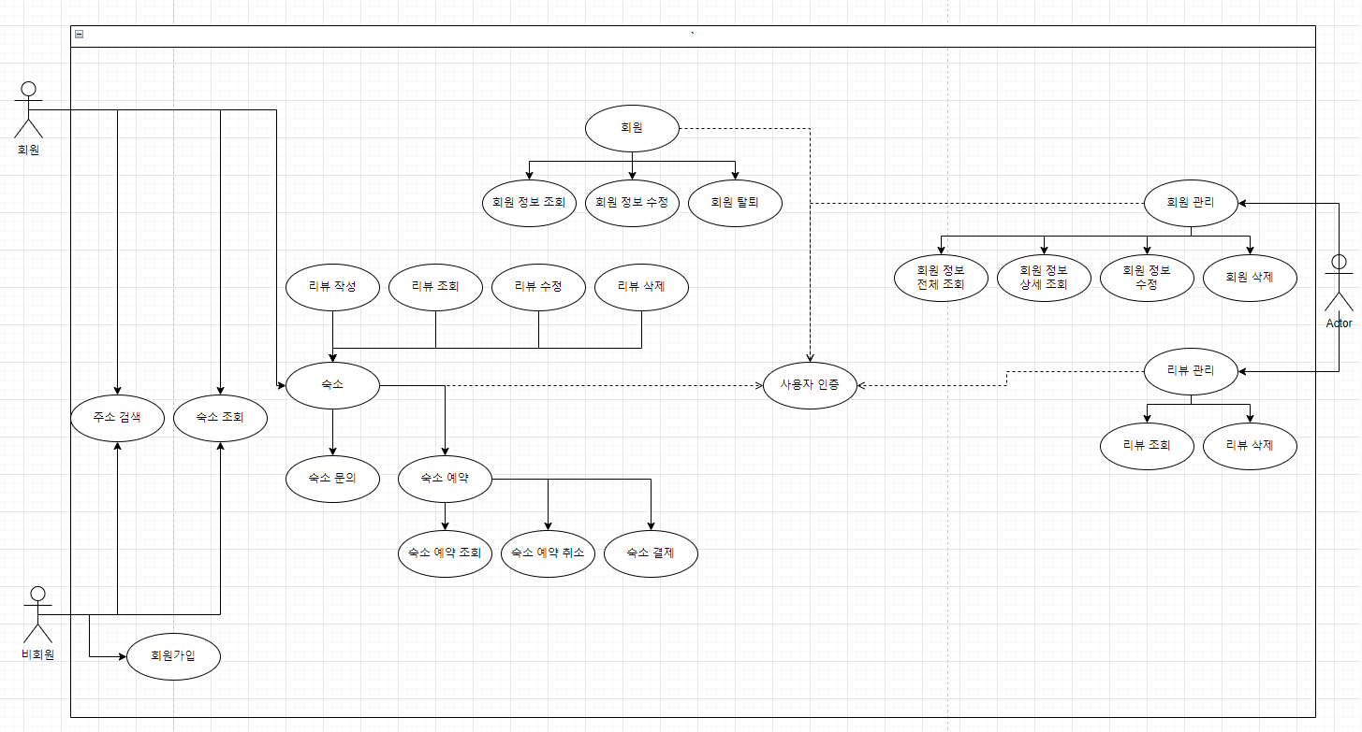
USECASE
USECASE

Slide 13
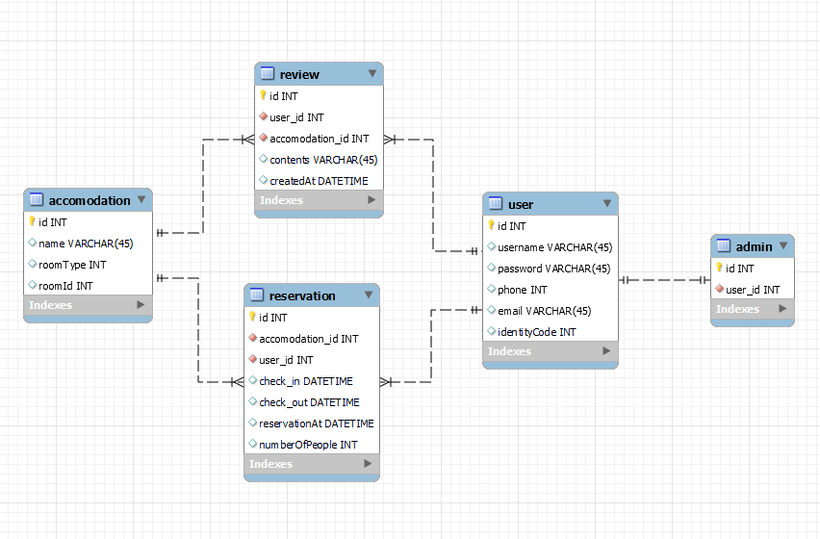
ERD
ERD

Slide 14
클래스 다이어그램
이미지
이미지
이미지
클래스 다이어그램

Slide 15
API 문서화
이미지
이미지
이미지
API 문서화

Slide 16
감사합니다

